Slide 1

COMBINED CYCLE Power Plant
Project(P127)
Team-6

Slide 2
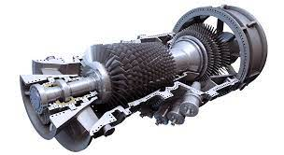
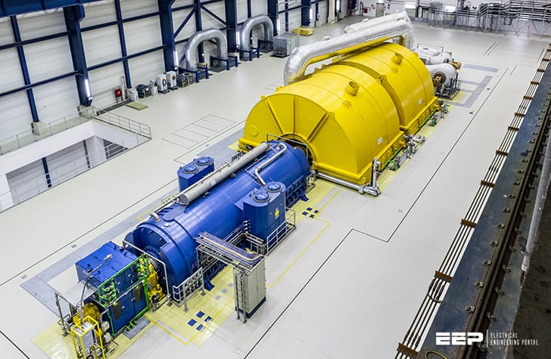
Business Objective
Gas Turbine
Steam Turbine
The electricity is generated by Gas and Steam turbines combined in one cycle.
We have to model the energy generated as a function of exhaust vacuum and ambient variables and use that model to improve the plant's performance

Slide 3

Exploratory Data Analysis(EDA)
Team - 6
Umesh Karnam
Lalith Kumar
Md Nasir Ali
Shaik Huda
Khushboo Krishna Tiwari
Mohammed Haaris
Rushikesh Wadekar

Slide 4
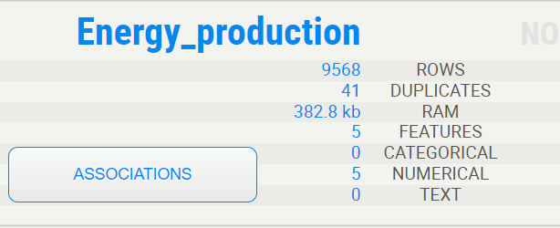
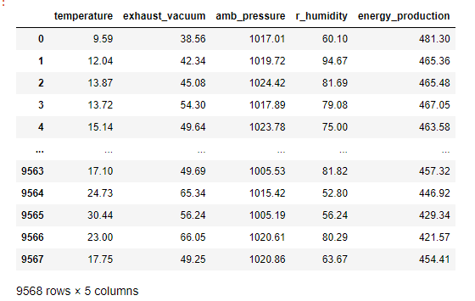
Project Details
Features | Data Types
temperature - in degrees Celsius | Float 64
Exhaust vacuum - in cm Hg | Float 64
Amb_pressure(Ambient Pressure) - in millibar | Float 64
r_humidity(Relative humidity) - in percentage | Float 64
energy_production - in MW(Million watts) | Float 64

Slide 5
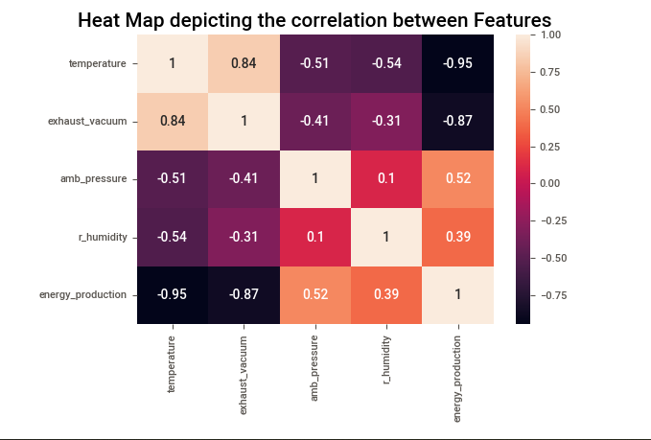
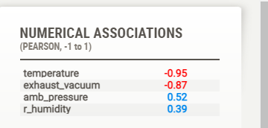
Visualizations
Observation:
With Energy Production,
Temperature & exhaust vacuum have a highly negative correlation
Ambient pressure & Relative humidity have a positive correlation

Slide 6
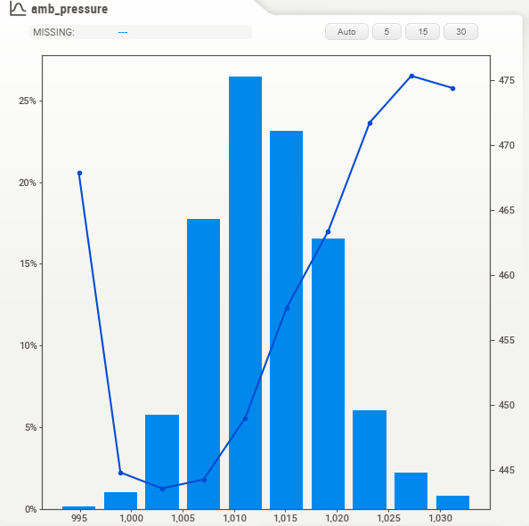
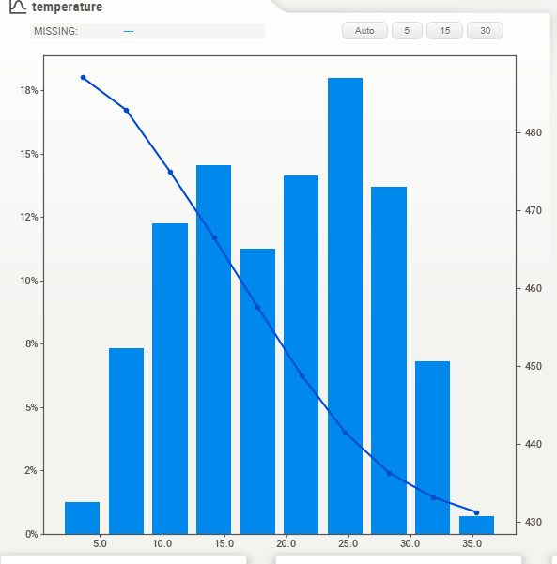
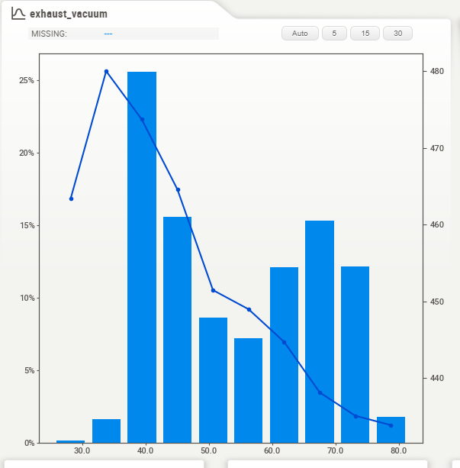
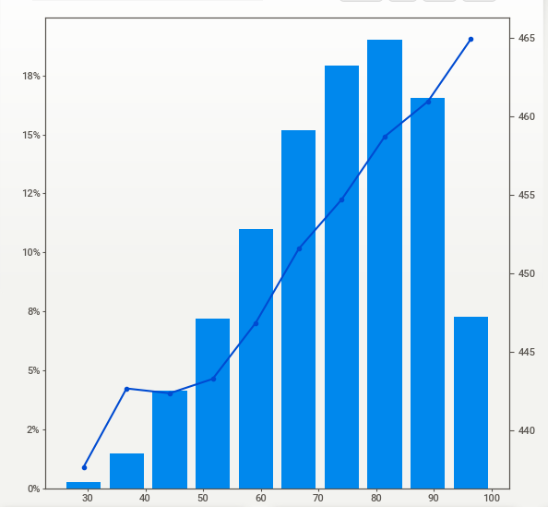
Positively correlated
Ambient Pressure
Temperature
Negatively Correlated
As the Temperature & Exhaust vacuum Increases Energy production Decreases
Inversely Proportional
Relative humidity
Exhaust vacuum
As the Ambient Pressure & Relative humidity Increases Energy Production Also Increases
Directly Proportional

Slide 7
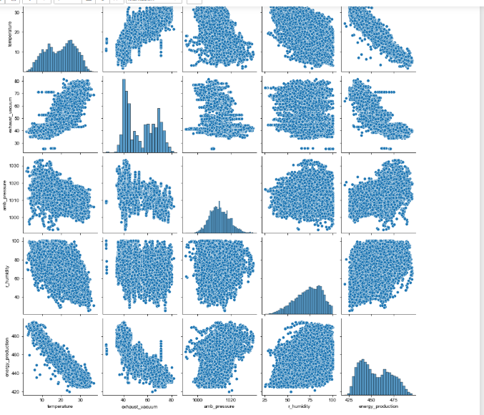
Pair Plot

Slide 8
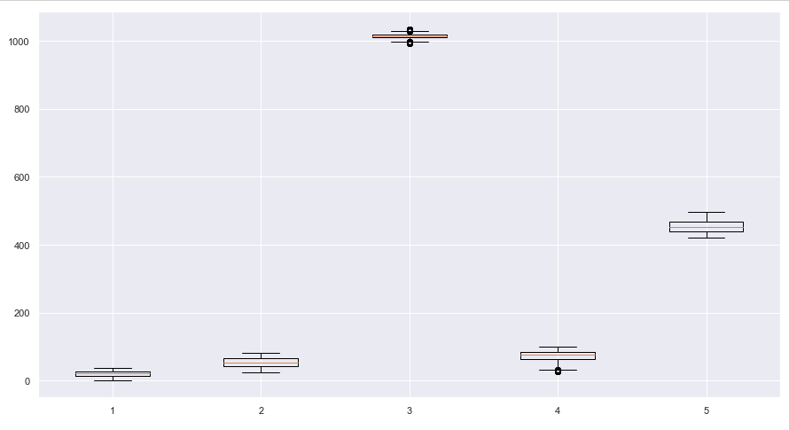
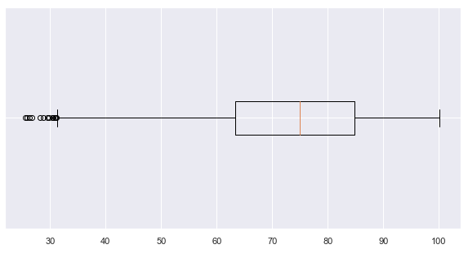
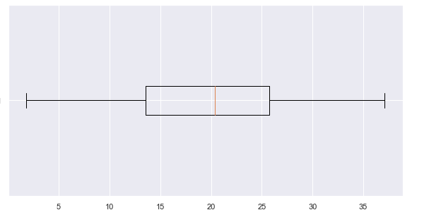
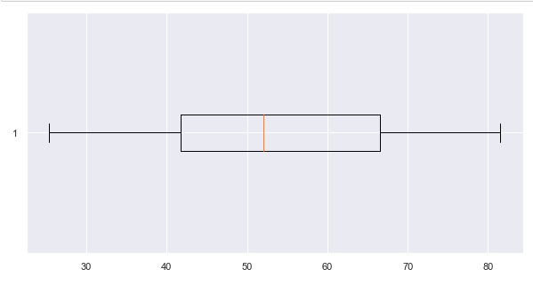
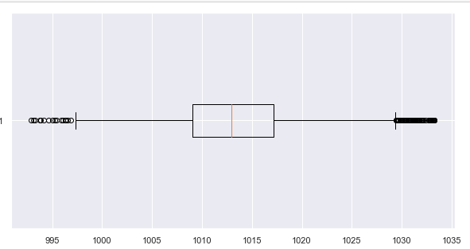
Outliers Detection
Relative Humidity
Temperature
Exhaust Vacuum
Ambient Pressure

Slide 9
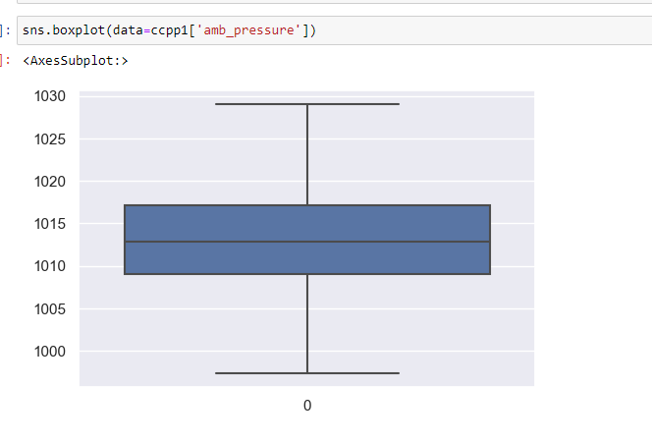
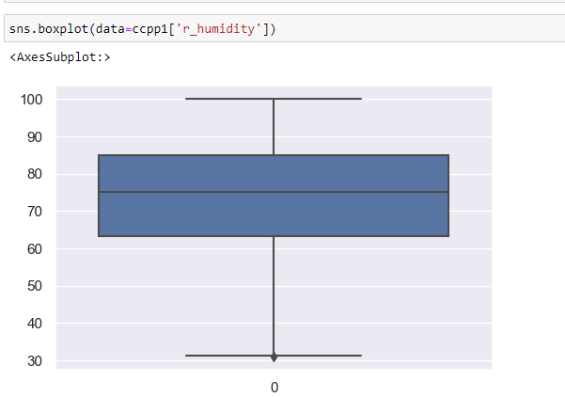
After Removal of Outliers
Ambient Pressure
Relative Humidity

Slide 10
Inference
Original Dataset contains – 9568 Observations
Duplicates – 47 Observations
After Removal of Duplicates – 9527 Observations
After Removal of Outliers – 9418 Observations
Final Data set Contains – 9418 Observations

Slide 11
Model Building
Models We have Used
Linear Regression
Decision Tree Regressor
Random Forest Regressor
Gradient Boosting Regressor
Support Vector Regressor
XGBoost
Lasso Regressor
Ridge Regressor
Kneighbors Regressor
AdaBoost Regressor
Neural Networks

Slide 12
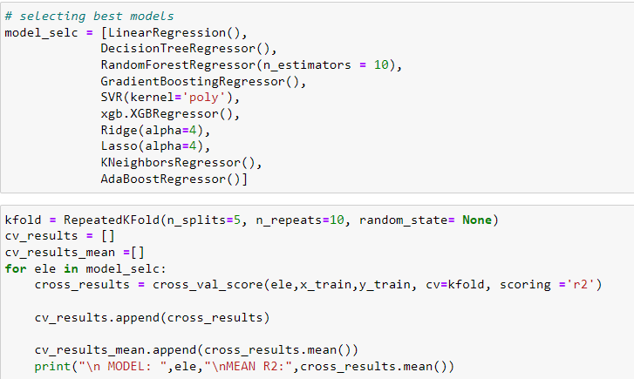
Selecting the Best Model Through Grid Search CV

Slide 13
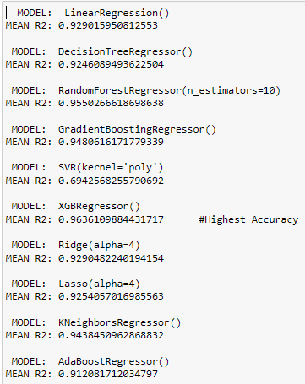
Models With R-Squared Values
Why R-Squared ???
R-squared shows how well the data fit the regression model (the goodness of fit)

Slide 14


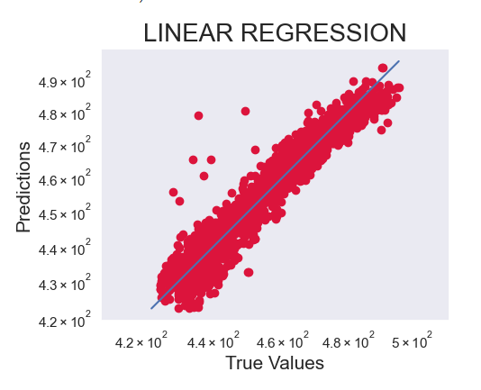

Fitting the Data With Different Models
1. Linear Regression
Errors:
R-Squared Value:
Mean Absolute Error:
Mean Squared Error:
Root Mean Squared Error:
Root Mean Squared Log Error:

Slide 15

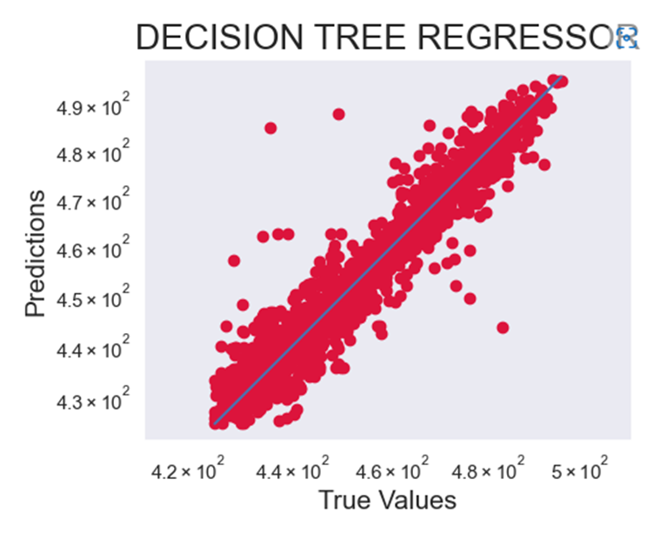


2. Decision Tree Regressor
Errors:
R-Squared Value:
Mean Absolute Error:
Mean Squared Error:
Root Mean Squared Error:
Root Mean Squared Log Error:

Slide 16

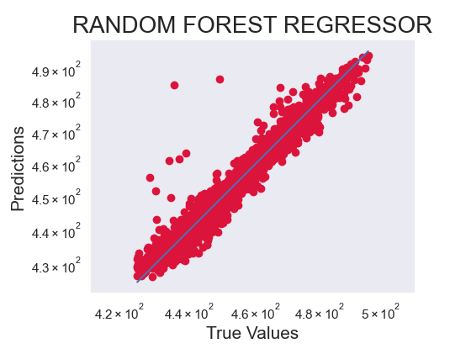
3. Random Forest Regressor
Errors:
R-Squared Value:
Mean Absolute Error:
Mean Squared Error:
Root Mean Squared Error:
Root Mean Squared Log Error:

Slide 17

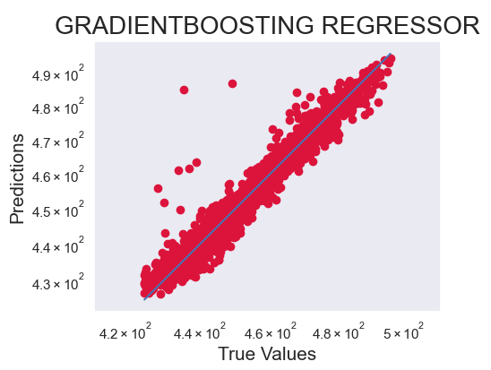
4. Gradient Boosting Regressor
Errors:
R-Squared Value:
Mean Absolute Error:
Mean Squared Error:
Root Mean Squared Error:
Root Mean Squared Log Error:

Slide 18


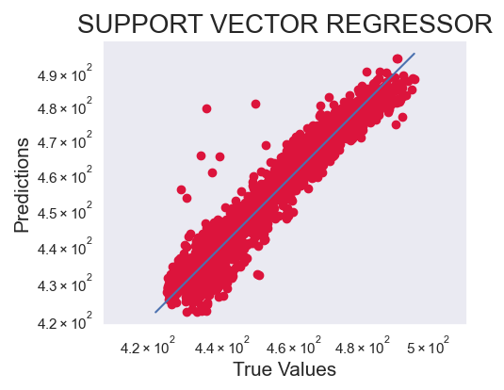
5. Support Vector Regressor
Errors:
R-Squared Value:
Mean Absolute Error:
Mean Squared Error:
Root Mean Squared Error:
Root Mean Squared Log Error:

Slide 19

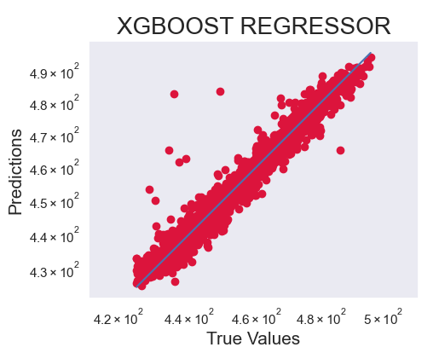
6. XGBoost
Errors:
R-Squared Value:
Mean Absolute Error:
Mean Squared Error:
Root Mean Squared Error:
Root Mean Squared Log Error:

Slide 20

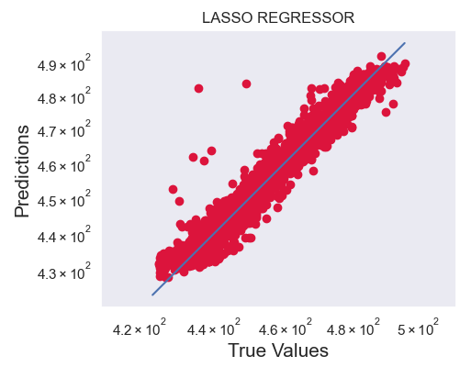

7. Lasso Regressor
Errors:
R-Squared Value:
Mean Absolute Error:
Mean Squared Error:
Root Mean Squared Error:
Root Mean Squared Log Error:

Slide 21

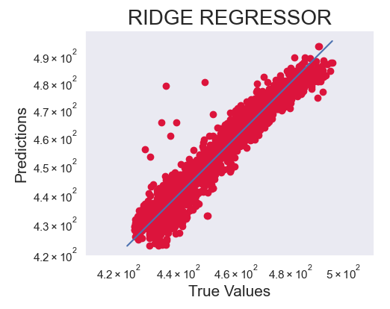
8. Ridge Regressor
Errors:
R-Squared Value:
Mean Absolute Error:
Mean Squared Error:
Root Mean Squared Error:
Root Mean Squared Log Error:

Slide 22

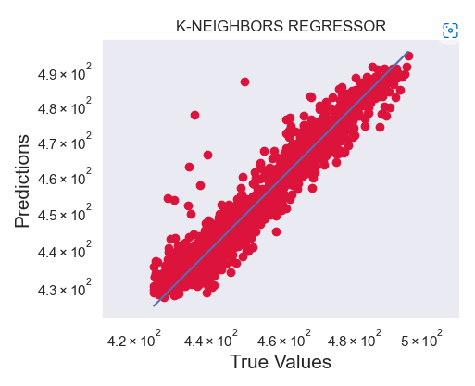
9. Kneighbors Regressor
Errors:
R-Squared Value:
Mean Absolute Error:
Mean Squared Error:
Root Mean Squared Error:
Root Mean Squared Log Error:

Slide 23

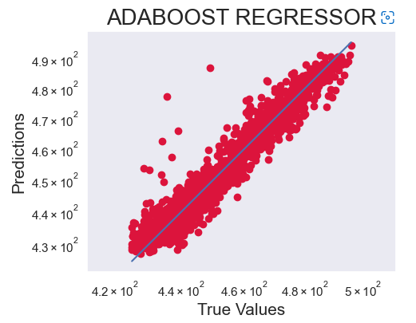
10. AdaBoost Regressor
Errors:
R-Squared Value:
Mean Absolute Error:
Mean Squared Error:
Root Mean Squared Error:
Root Mean Squared Log Error:

Slide 24
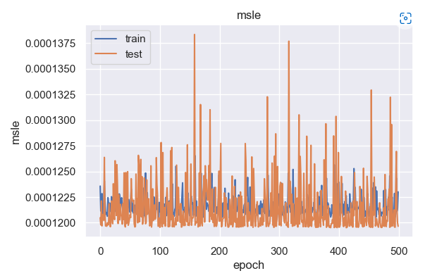
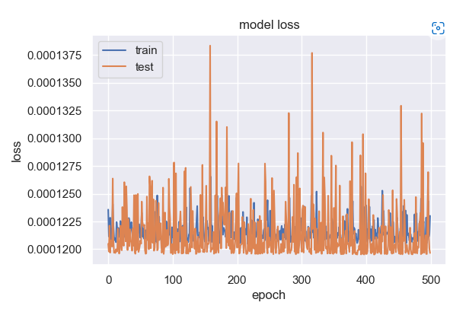
11)Neural Networks
Mean Squared log Error
Model Loss
Error value in Test data is more when compared to Train Data
Model Loss in Test Data is more when compared to Train Data

Slide 25
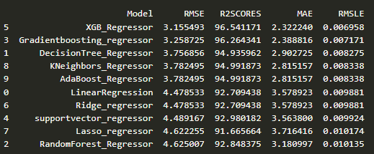

Tabulating All model Performances
After Removing Outliers

Slide 26
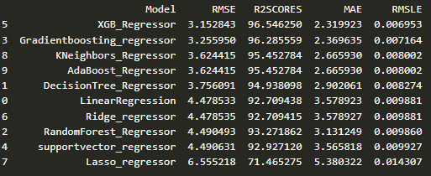

After Removing Outliers And Standardizing the Data

Slide 27
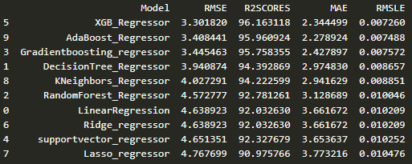

Before Removing Outliers And without Standardizing the Data

Slide 28
The Final Model We have Chosen is...
XGBoost Regressor – After Removing Outliers And Standardizing the Data
Accuracy – 96%
RMSE – 3.15
MAE – 2.31
RMSLE – 0.00
MSE – 9.94

Slide 29
Thank You...

